Slide 1

Welfare Conditionality in Canada
University of York, 30 Jan 2019
Willem Maas
Glendon College, York University
maas@yorku.ca

Slide 2
Questions
Welfare conditionality in Canada
In every jurisdiction, eligibility for social assistance determined on basis of needs test: household’s financial assets + income below limits set by province/territory.

Slide 3
Questions
Welfare conditionality in Canada: Federal
Canada Child Benefit: $6496/yr per child under 6 plus $5481/yr per child 6-17 (reduced starting @$30.5K income).
- Applicant (+ partner, if applicable) must file tax return every year, even if no income.
- Applicant must live with child, child must be under 18 years, applicant must be primarily responsible for care/upbringing, applicant must be resident of Canada for tax purposes, and either applicant or spouse must be either: Canadian citizen, permanent resident, protected person, temporary resident who has lived in Canada for previous 18 months and who has valid permit in 19th month, or “an Indian within the meaning of the Indian Act.”

Slide 4
Questions
Welfare conditionality in Canada: Federal
Employment Insurance (EI): Applicant eligible if employed at insurable company; lost job through no fault of own; have been without work+pay for 7+ consecutive days in last 52 weeks; have worked for required # hours in last 52 weeks since start of last EI claim (depending on unemployment rate in area); are ready, willing, + capable of working each day; and actively looking for work (must keep a written record of employers contacted + date of contact).
- Applicant may not be entitled to benefits if: voluntarily left job without just cause, dismissed for misconduct, unemployed due to participation in labour dispute, if on a period of leave compensating for working more hours than normally works, or if confined to jail, penitentiary, or similar institution.
- To prove eligibility and receive benefits, applicant must complete bi-weekly reports. Failure to do so will result in loss of benefits.

Slide 5
Questions
Welfare conditionality in Canada: Ontario
Ontario Works: applicant must be in immediate financial need (urgent need for food + shelter), must live in Ontario, must be willing to participate in activities to find job: “Participation Agreement” (PA).
- PA reviewed typically every 3 mo, but caseworker may choose 3,4,6 mo intervals (or agree on temporary deferral of participation) as long as recipient’s circumstances have not changed. If circumstances change, PA must be reviewed immediately. Refusal to participate or failure to make meaningful effort to participate → benefits cancelled (single recipients) or reduced (when other members in benefit unit). First instance of non-compliance, cancellation lasts one month; subsequent non-compliant behavior = cancellation for 3 mo.
- If restrictions on participation requirements needed for emergencies, religious reasons, or health needs (a.o.), must be supported by documentation, e.g. from religious leader or health care practitioner.

Slide 6
Questions
Welfare conditionality in Canada: Ontario
Ontario Works: Maximum asset limits for single recipients cap $10K while asset limits for recipients with spouse cap $15K. Dependants add $500 each to asset limit.
- Applicant or recipient may dispose of assets or do so prior to applying for OW. If this occurs, benefits can be denied or cancelled if assets “disposed of inadequately” (e.g. sold for under market value) or disposed of in order to qualify for OW. History of inadequate asset disposal + disposal of assets close to time of application will be taken into consideration if applicable, and period reviewed for asset disposal is one year, unless Administrator feels that a three-year period is best.
- Recipient/member of benefit unit cannot leave Ontario for more than 7 days. If this occurs, benefits will be reduced or cancelled unless Administrator deems absence necessary for health purposes or exceptional circumstances.
.

Slide 7
Questions
Welfare conditionality in Canada: Ontario
Ontario Disability Support Program (ODSP): Applicant must be 18+, resident of Ontario, demonstrate financial need, meet definition of person with disability: have substantial mental or physical impairment (continuous or recurrent + expected to last minimum of 1 year); impairment directly results in “substantial restriction” of working ability, ability for self-care, + ability to participate in community life; impairment + duration/restrictions have been verified by approved healthcare practitioner.
- Asset limits start at $40K for single recipient, $50K for couple, plus $500 per dependant.

Slide 8
Questions
Welfare conditionality in Canada: Ontario
Ontario Child Benefit (OCB): Eligibility based on # of children under 18 in family + family net income reported on tax return. Applicant must be resident of Ontario, be primary caregiver (as defined by Canada Revenue Agency), file income tax return, register children for Canada Child Benefit, have net income below OCB income levels (benefits begin for net incomes under $30K).

Slide 9
Questions
Welfare conditionality in Canada: Toronto
Social Housing, Rent-Geared to Income (RGI): Rent at subsidized unit set @ 30% of household’s total monthly income. At least one member of household must be 16+; must be able to live independently (with or without support services); each member of household must be Canadian citizen, permanent resident, applied for permanent residence, or refugee claimant or Convention refugee; no enforceable removal order pending against any member of household; no member of household owes arrears from former tenancy to social housing provider in Ontario (unless Housing Connections or provider deems circumstances extenuating, a member of household has signed agreement to pay money owing, or member of household has made reasonable efforts to enter into repayment agreement.

Slide 10
Questions
Welfare conditionality in Canada: Toronto
Social Housing, Rent-Geared to Income (RGI): if household owns residential property that can be lived in year-round, must sell property/share of property within 6 mo of moving into RGI unit. Same if residents of RGI unit inherit residential property that can be lived in year-round; reasonable grounds may justify extension beyond 6 mo.
- If housing provider believes household may be eligible for income (from Ontario Works, support payment from divorce, Employment Insurance benefits, pension, support/maintenance from sponsor), housing provider must give household written notice to try to obtain this income. Toronto recommends 60 days for households to make request for income + receive/submit reply to + housing provider. Failure to perform these tasks puts eligibility for RGI program at risk.

Slide 11
Questions
Welfare conditionality in Canada: Toronto
Social Housing, Rent-Geared to Income (RGI): Household ceases to be eligible if establishes lease/freehold interest in another housing unit.
- Household will cease to be eligible for RGI if all members have been absent from unit for more than 90 consecutive days or more than 90 days in 12 mo period. Absences of 7 consecutive days or less not counted. Temporary absences resulting from medical condition of a member of household not counted. Housing providers decide what is valid medical reason for absence + what documentation needed.
- Household may cease to be eligible for RGI (and thus will be charged market rent) if household: does not meet eligibility requirements; refuses three offers while on centralized waiting list; fails to provide necessary information + documents within timeframe; has paid market rent for one year.

Slide 12
Questions
Welfare conditionality in Canada: Toronto
Social Housing, Rent-Geared to Income (RGI):
- Eligibility can be risked if household fails to report changes in household composition, fails to report that students no longer attending post-secondary courses, or if household sublets all or part of subsidized unit.

Slide 13
Questions
Boundaries of Political Community
Case studies of the free movement of students and workers show that all governments must balance the desire for equal citizenship with demands for ‘own polity first’. Migration between US states or Canadian provinces raises worries about social dumping analogous to those raised by Euroskeptics concerned about EU free movement. Yet despite significant internal variation, overarching welfare programs assuage these worries about the ability of governments to control the boundaries of political community, and should be considered for Europe.
Willem Maas “Boundaries of Political Community in Europe, the US, and Canada,” Journal of European Integration 39:5 (2017).

Slide 14
Canada, Charter of Rights and Freedoms (1982):
Section 6 (2) Every citizen of Canada and every person who has the status of a permanent resident of Canada has the right
(a) to move to and take up residence in any province; and
(b) to pursue the gaining of a livelihood in any province.
(3) The rights specified in subsection (2) are subject to
(a) any laws or practices of general application in force in a province other than those that discriminate among persons primarily on the basis of province of present or previous residence; and
(b) any laws providing for reasonable residency requirements as a qualification for the receipt of publicly provided social services.
(4) Subsections (2) and (3) do not preclude any law, program or activity that has as its object the amelioration in a province of conditions of individuals in that province who are socially or economically disadvantaged if the rate of employment in that province is below the rate of employment in Canada.
Notes:
Section 6

Slide 15
Saenz: Comparative free movement
Internal Free Movement: Case of Canada
Social Union Framework Agreement (1999): Mobility within Canada
“All governments believe that the freedom of movement of Canadians to pursue opportunities anywhere in Canada is an essential element of Canadian citizenship.
Governments will ensure that no new barriers to mobility are created in new social policy initiatives. Governments will eliminate, within three years, any residency-based policies or practices which constrain access to post-secondary education, training, health and social services and social assistance unless they can be demonstrated to be reasonable and consistent with the principles of the Social Union Framework.”

Slide 16
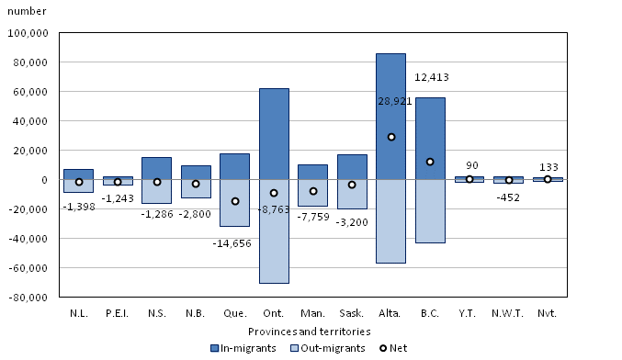
Interprovincial migration by province or territory, 2014/2015
Notes:
http://www.statcan.gc.ca/pub/91-215-x/2015000/ct012-eng.htm

Slide 17
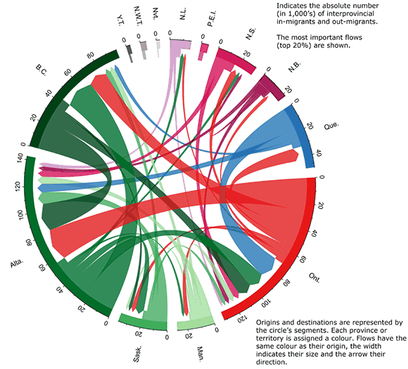
Largest interprovincial migration flows, by province or territory of origin and destination, 2014/2015
Notes:
http://www.statcan.gc.ca/pub/91-215-x/2015000/ct013-eng.htm

Slide 18
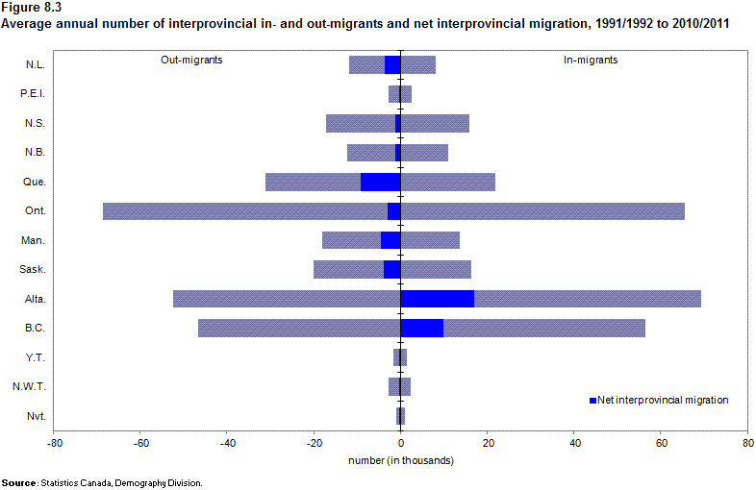

Slide 19
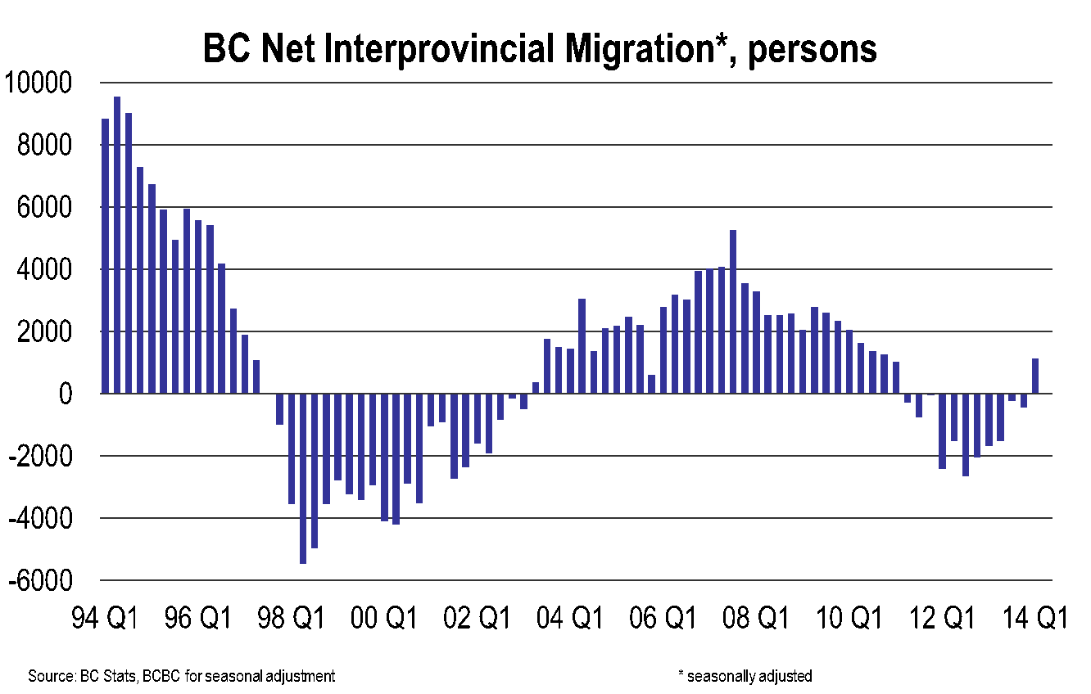
Saenz: Comparative free movement
Notes:
PM, Premier Settle B.C. Residency Dispute, Agree to New Co-operation on Mobility, Immigration and Asia-Pacific 3June1997
VANCOUVER -- Prime Minister Jean Chretien and Premier Glen Clark today announced their governments have reached agreement on a range of issues.
In announcing the agreements, the prime minister said, "British Columbians, and all Canadians, want to see their governments working together both to solve the problems of today and to seize the opportunities of tomorrow. Premier Clark and I have taken an important step in that direction today. I am very pleased that we have found a way to remove barriers to mobility in Canada.[…]
"This agreement is a win both for Canada and for B.C.," said Clark. "The prime minister and I have been able to work out a resolution to some long-standing issues which reflect both the Government of Canada's objectives and the special circumstances we face here in B.C."
The premier added, "This agreement enhances our ability to welcome newcomers to our country. It acknowledges that B.C. faces special challenges not encountered by other provinces because of its unique role as Canada's gateway to the Asia Pacific. This agreement will see the Government of Canada bear a greater share of the costs associated with that role. At the same time, it acknowledges the special pressures faced by B.C. as a result of internal migration.
"We have agreed to a two-year review of this issue and B.C. will be consulted on the terms of reference. In recognition of this acknowledgement, we are lifting our residency requirement."

Slide 20
Saenz: Comparative free movement
PM, Premier Settle BC Residency Dispute, Agree to New Co-operation on Mobility, Immigration and Asia-Pacific 3June1997
Government of Canada acknowledges the special pressures faced by BC as a result of internal migration.
…to settle the residency dispute, BC will withdraw its requirement that people reside in the province for three months before qualifying for social assistance. In turn, the Government of Canada will reduce the $46.9m penalty imposed on BC in 1995 to $20.3m.
…Government of Canada will increase its immigration settlement funding in BC by $22.4m this year and in each of the next two years, for a total of $67.2m, as part of a new Canada-BC agreement.
The prime minister and premier agreed there is a need for all provinces and the federal government to work together on issues related to mobility and how it can be promoted most effectively… Government of Canada will raise the issue with all provinces and work toward a national solution within two years.
Notes:
PM, Premier Settle B.C. Residency Dispute, Agree to New Co-operation on Mobility, Immigration and Asia-Pacific 3June1997
VANCOUVER -- Prime Minister Jean Chretien and Premier Glen Clark today announced their governments have reached agreement on a range of issues.
In announcing the agreements, the prime minister said, "British Columbians, and all Canadians, want to see their governments working together both to solve the problems of today and to seize the opportunities of tomorrow. Premier Clark and I have taken an important step in that direction today. I am very pleased that we have found a way to remove barriers to mobility in Canada.[…]
"This agreement is a win both for Canada and for B.C.," said Clark. "The prime minister and I have been able to work out a resolution to some long-standing issues which reflect both the Government of Canada's objectives and the special circumstances we face here in B.C."
The premier added, "This agreement enhances our ability to welcome newcomers to our country. It acknowledges that B.C. faces special challenges not encountered by other provinces because of its unique role as Canada's gateway to the Asia Pacific. This agreement will see the Government of Canada bear a greater share of the costs associated with that role. At the same time, it acknowledges the special pressures faced by B.C. as a result of internal migration.
"We have agreed to a two-year review of this issue and B.C. will be consulted on the terms of reference. In recognition of this acknowledgement, we are lifting our residency requirement."

Slide 21
Employment + mutual recognition of credentials
Employment/credentials provincial (not federal) jurisdiction → internal migration sometimes easier in EU than Canada.
Fairness is a Two-Way Street Act (Ontario) 1999-2006
Quebec laws hinder Ontario construction workers +
tradespeople to work in Quebec, so Ontario retaliates.
Bilateral negotiations result in Ontario-Quebec Trade and Cooperation Agreement 2009

Slide 22
Health care and medical federalism
Significant interprovincial differences in pharmacare:
“A person with a $20,000 annual drug bill - not unusual for a cancer patient or someone with a chronic condition like rheumatoid arthritis - would pay nothing in NWT, $1500 in Quebec, $8000 in Saskatchewan and $20,000 in PEI.”

