Slide 1

Dr Tom Boland | Dr Ray Griffin
WIT | Ireland

Slide 2





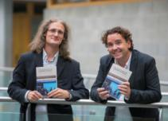


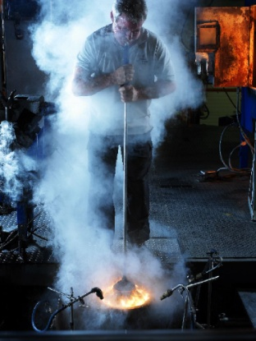

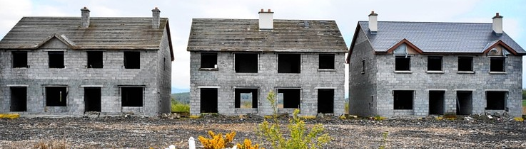

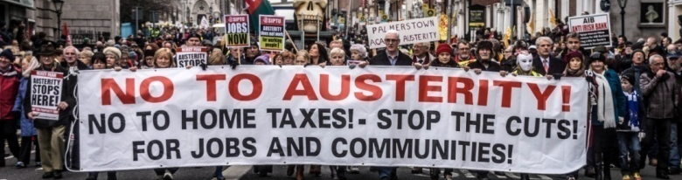
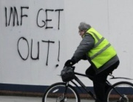
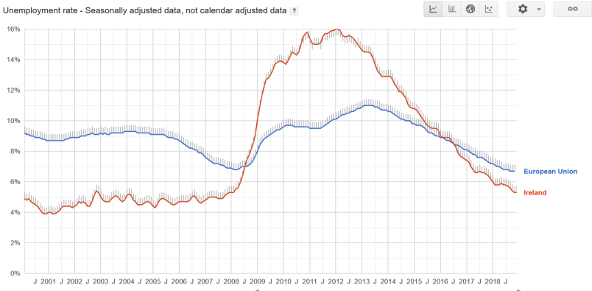
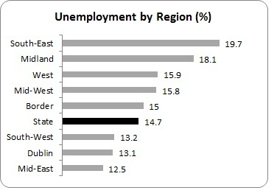
The Work of WUERC
2012 WUERC 1
32 autoethnographies of welfare offices
Deconstructing application forms
Critique of corpus of jobseekers advise
32 interviews with ‘jobseekers’
2014 WUERC 2
12 interviews with activated ‘jobseekers’
736 views of unemployment blackspots
Critique of unemployment statistics
Analysis of 5 years of popular press discourse
Conditions of unemployment
Disciplinary architectures
of unemployment
2016 WUERC 3
32 interviews with activated ‘jobseekers’
32 Places of jobseeking
Analysis of 32 job application forms
Set-Cia case
Sanctioning in Ireland
2018 WUERC 4
20 interviews with activated ‘jobseekers’
W+W4 PEX Big data and algo
Updated analysis discourse (2002-2018)
Moral Foundations/genealogy
Ethnography of a scheme
Notes:
KD- 25 interviews

Slide 3
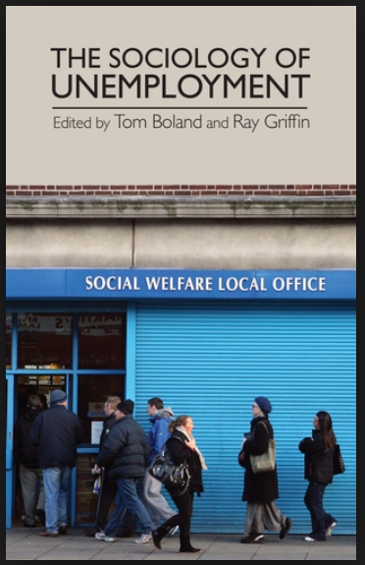


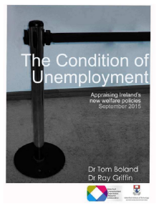
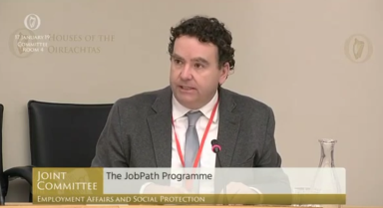
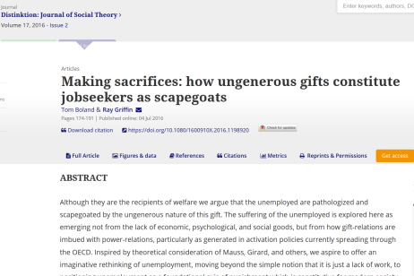
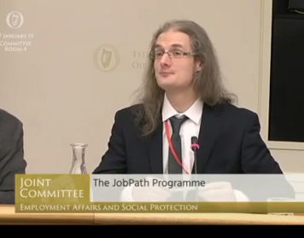
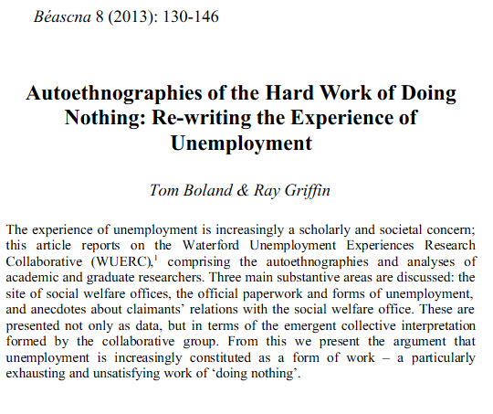
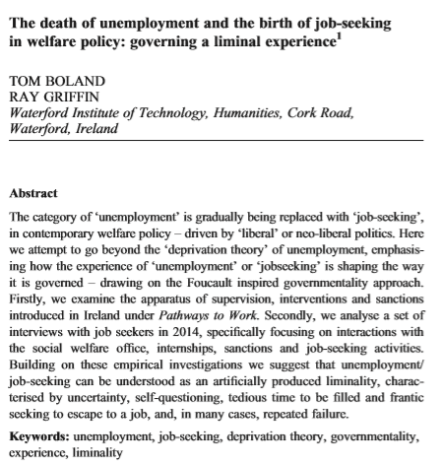
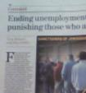

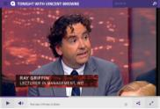

Individual experience of unemployment
State as a labour market actor, orchestrator, Svengali
Origins of unemployment
| Genealogy of the political economy of social protection
Moral foundations of activation + conditionality
Interconnections of experience and welfare processes.
Broad concepts
Policy + Advocacy

Slide 4



Conditionality in Ireland
Human-K-centric until 2012
Radical introduction, now conditionality-creep
Basic rubric 9 week reduce or withdrawal
From >1,500 in 2012, to 16,400 in 2018, no consistency, 59% appeal successful
Fundamentally a political marketing exercise

Slide 5

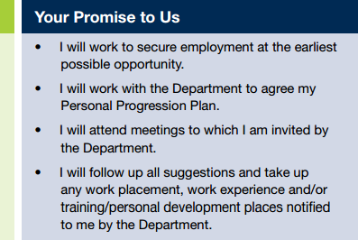
Conditionalised welfare :
Behavioural compliance
Work-first orientation
Institutionalised sanctions

Slide 6
Experiences of Unemployment
Filling the time is the killer. It is now...
But it is...all you have to do is to talk to some people and they’re so down and depressed about doing absolutely nothing.
I’m available now but I’m sitting on my fucking arse, ya know what I mean, what’s the difference,
You’d think when you’re employed that having the days to yourself would be great. Well that’s so far from reality. It’s crap. Ther is nothin sweeter than slobbing in front of crap TV after a hard day’s work.. There is nothing worse than slobbing in front of crap TV after a hard days nothing!
you do start to develop cabin fever, you get stuck in the door, and you kind of even subconsciously, if you directly thought about it you’d look stupid but you kind of think if i keep sitting here, what the fuck amd I going to do? and it does bear down on you and it takes a huge smack, a huge chunk out of you your self-esteem, you ... feel kind of a prisoner.
some days are as long – like two years in a day, like. I’d be good, I do try and ehm, I couldn’t just get up and sit around and do nothing; I’d have to get up and do something so that when I do sit down, I do feel like – well look it; I can sit down now, I’m after doing something you know that way?

Slide 7
Experiences of Conditionality
Goin in and lookin' at these things being pulled down and lookin' at DVD's wasting 2 or 3 hours questioning ya and you're goin I already answered that 6 or 8 weeks ago. Then they'd wait for 2 or 3 months, do you wanna do a computer course, do you wanna do this, do you wanna do that?
I'm not really employed at all. The thing about it is, it's quite demoralizing 'cause you're up in the morning and you're waiting for the phone to ring, hoping that a teacher will be absent and the phone will ring at half 7 or 8am. Or 8.30 am, or 8.45am
Desperation sets in and you’ll apply for anything you know?
The routine is really panically looking for jobs for two hours on jobs online and then crying into your Coco-Pops because you can’t find anything, right? That’s been the, that is the routine.
It was an automatic sanction, I kind of learned from that so I wouldn’t go against them, because for that twelve weeks I had to beg and borrow, so therefore I have never out stepped where I was supposed to be. So any course that they made me do I went and did them. That was enough to put me in tow

Slide 8
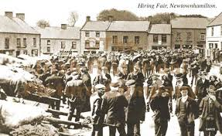
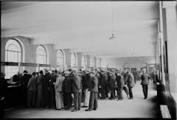


Market Coaxing: The State as middleman

Slide 9
Dr Tom Boland | Dr Ray Griffin
WIT | Ireland
www.wuerc.com

