Slide 1
Universal Credit
New means tested benefit for working age people
Gradual roll out: 2013-2023
Government’s aims:
Simplify the benefits system
Improve incentives to undertake paid work
Key changes:
Monthly payment
Digital claims
Single taper rate
Conditionality and sanctions intensified

Slide 2
Age of youngest child | Work-related requirements
Under one | You don’t need to look for work in order to receive Universal Credit.
Age 1 | You will be asked to attend work focused interviews with your work coach to discuss plans for a future move into work.
Age 2 | You will be expected to take active steps to prepare for work.
Age 3 or 4 | You will be expected to work a maximum of 16 hours a week (or spend 16 hours a week looking for work).
Age 5 – 12 | You will be expected to work a maximum of 25 hours a week (or spend 25 hours a week looking for work).
Age 13 and above | You will be expected to work a maximum of 35 hours a week (or spend 35 hours a week looking for work).
Source: DWP 2017 Universal Credit: Further information for families

Slide 3
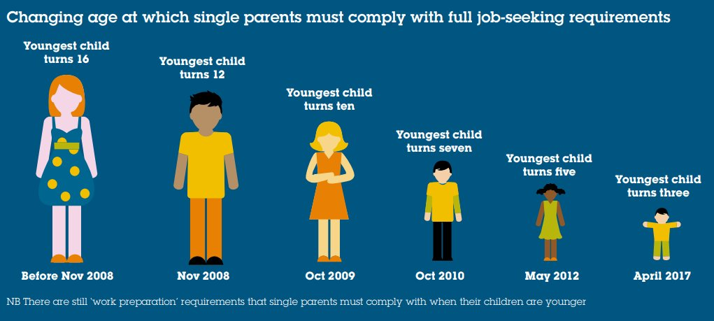
Source: Gingerbread 2018, Unhelpful and unfair? The impact of single parent sanctions

Slide 4
Participant | Single or joint claim | Number of children | Highest qualification | Region | Age of participant
Abby | Joint | 2 | College certification | Yorkshire | 20s
Angie | Single | 1 | Postgraduate diploma | Yorkshire | 40s
Anwen | Joint | 2 | Degree | North East | 30s
Claire | Single | 1 | Degree | North West | 20s
Gemma | Single | 2 | College certification | Yorkshire | 20s
Helen | Single | 1 | College certification | North West | 30s
Kim | Joint | 5 | A-Levels | East of England | 30s
Nicky | Single | 1 | GCSEs | South West | 20s
Stephanie | Joint | 2 | College certification | South West | 20s
Vicky | Single | 1 | Degree | Yorkshire | 30s

Slide 5
She asked me what I wanted and we talked it through together for what would be best within my circumstances. Nicky, lone mother, one child
They didn't really talk about that [caring responsibilities] to me much but I don't think they really care about that. They made me feel as though I just needed to get back to work. They didn't really care about how I would find childcare for training or how it would affect my children. Stephanie, coupled mother, two children
In terms of what they write on the Commitment it’s very by the book and so it’s like strict...they’re expecting you to do all these things and they don’t think about care and you’ve got a child at home. Helen, lone mother, one child

Slide 6
In order to do that job-search I’m having to shirk mothering responsibilities.
Anwen, coupled mother, two children
I’ve got her older brother looking after her. You know he’s never looked after her so much as he has done in the last five months. Anwen, coupled mother, two children
I don't think they understand how hard it is to care for children and how much of
your time it takes up. Stephanie, coupled mother, two children
Things that are really important like being able to read with them after school and being able to go out and buy them a pair of shoes because you’ve got time. Those things are not seen as important you know they are important.
Anwen, coupled mother, two children

Slide 7
I find a time where if he’s playing out in the garden I’ll just sit in the garden with the tablet and do a little bit or I do a bit when he’s in bed. Even when he’s in the bath sometimes I sit next to him and just check my emails.
Helen, lone mother, one child
It's an awful lot of hassle and stress, and they make you feel so low. Stephanie, coupled mother, two children

Slide 8
We have made sure we have never missed an appointment and we are doing more than what is actually asked. Kim, coupled mother, five children
I don’t give them an inch. I don’t give them any opportunity to say you’ve
not done this we’re going to sanction you. I cover my back thoroughly.
Anwen, coupled mother, two children
Either one of us drops the ball that’s a loss of money...you can’t risk that ball being dropped or it happening for stupid reasons.
Anwen, coupled mother, two children

Slide 9
Universal Credit policy fails to value and recognise women’s roles and responsibilities leading to adverse impacts for women and their caring responsibilities.
The joint claim is problematic for the citizenship rights of partnered women.
Subjecting mothers to conditionality works against aims to redefine citizenship so that it is more inclusive of women.

Slide 10
Current research
Investigating how the conditionality within Universal Credit affects:
mothers’ employment trajectories
the valuing of informal care
mothers’ agency in relation to engagement in informal care and paid work
Methods:
Qualitative longitudinal research (two waves of interviews, nine months apart)
Aim: recruit twenty-five mothers who are in receipt of Universal Credit and who are required to prepare for work or job-search
Progress to date:
Fourteen mothers from one city recruited and interviewed (twelve single mothers, two coupled mothers)

